Slide 1
The Application Layer
Lecturer: Ngo Huy Bien
Software Engineering Department
Faculty of Information Technology
VNUHCM - University of Science
Ho Chi Minh City, Vietnam
nhbien@fit.hcmus.edu.vn

Slide 2

References

Slide 3
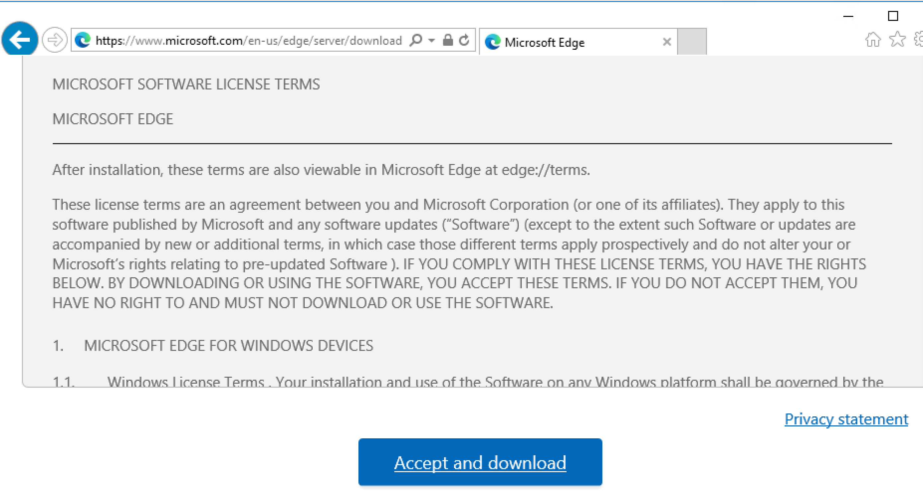
1. Install Edge on Server 2016
https://www.microsoft.com/en-us/edge/server/download

Slide 4


Slide 5
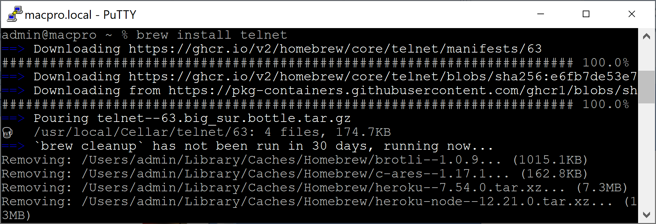
1. Install Telnet in macOS
brew install telnet

Slide 7
What is Bring Your Own Device (BYOD)?
http://en.wikipedia.org/wiki/Bring_your_own_device
Bring Your Own Device (BYOD) describes the recent trend of employees bringing personally-owned mobile devices to their place of work, and using those devices to access privileged company resources such as email, file servers, and databases.
The potential sensitivity of BYOD requires that it utilize a secure wireless protocol, most commonly WPA2-Enterprise.
Compatibility of employee hardware with organization software and applications should not be overlooked when considering BYOD.

Slide 8
Captive Portal
http://en.wikipedia.org/wiki/Captive_portal
The captive portal technique forces an HTTP client on a network to see a special web page (usually for authentication purposes) before using the Internet normally. A captive portal turns a Web browser into an authentication device.
This is done by intercepting all packets, regardless of address or port, until the user opens a browser and tries to access the Internet. At that time the browser is redirected to a web page which may require authentication and/or payment, or simply display an acceptable use policy and require the user to agree.

Slide 9
Simple Certificate Enrollment Protocol
http://en.wikipedia.org/wiki/Simple_Certificate_Enrollment_Protocol
Simple Certificate Enrollment Protocol (SCEP) is a protocol designed to make the issuing and revocation of digital certificates as scalable as possible.
The idea is that any standard network user should be able to request their digital certificate electronically and as simply as possible. These processes have usually required intensive input from network administrators, and so have not been suited to large scale deployments.

Slide 10
Extensible Authentication Protocol
http://en.wikipedia.org/wiki/Extensible_Authentication_Protocol
EAP is an authentication framework providing for the transport and usage of keying material and parameters generated by EAP methods.
There are many methods defined by RFCs and a number of vendor specific methods and new proposals exist.
EAP is not a wire protocol; instead it only defines message formats. Each protocol that uses EAP defines a way to encapsulate EAP messages within that protocol's messages.

Slide 11
Internet Protocol (IP) Telephony
http://searchunifiedcommunications.techtarget.com/definition/IP-telephony
IP telephony (Internet Protocol telephony) is a general term for the technologies that use the Internet Protocol's packet-switched connections to exchange voice, fax, and other forms of information that have traditionally been carried over the dedicated circuit-switched connections of the public switched telephone network (PSTN).
Using the Internet, calls travel as packets of data on shared lines, avoiding the tolls of the PSTN.

Slide 12

Thank You & See You Again

